Slide 1


Right Food for healthy life
Using machine learning techniques to Choose right food category based on nutrients present in the data
Ashuthosh Chandramouli

Slide 2

Motivation to do the project
Health is Wealth. A healthy man is more proactive and efficient at work. He will be an asset to an organization and to the society.
In order to be healthy, a person must eat right and exercise regularly. Food plays a major role in a person's health.
Right Food is the key for healthy life.
We often shop groceries or ready-to-eat products without even looking at the nutrient present in it. Realizing it, I wanted to do an analysis which will help me pick right food products based on the nutrient levels I am looking at.

Slide 3


Objectives
The goal of this project is to check the amount of calories and other nutrient present in different categories of food using machine learning models
Implement Machine Learning Model
Normalization techniques
Support Vector Machines
Predicting the accuracy of the model
Model ready for real time implementation

Slide 4
Nutrients Chart We see this chart on most of the products. But not all of us care much about the data given on those charts. Choosing the right food is the key for a healthy life

Slide 5
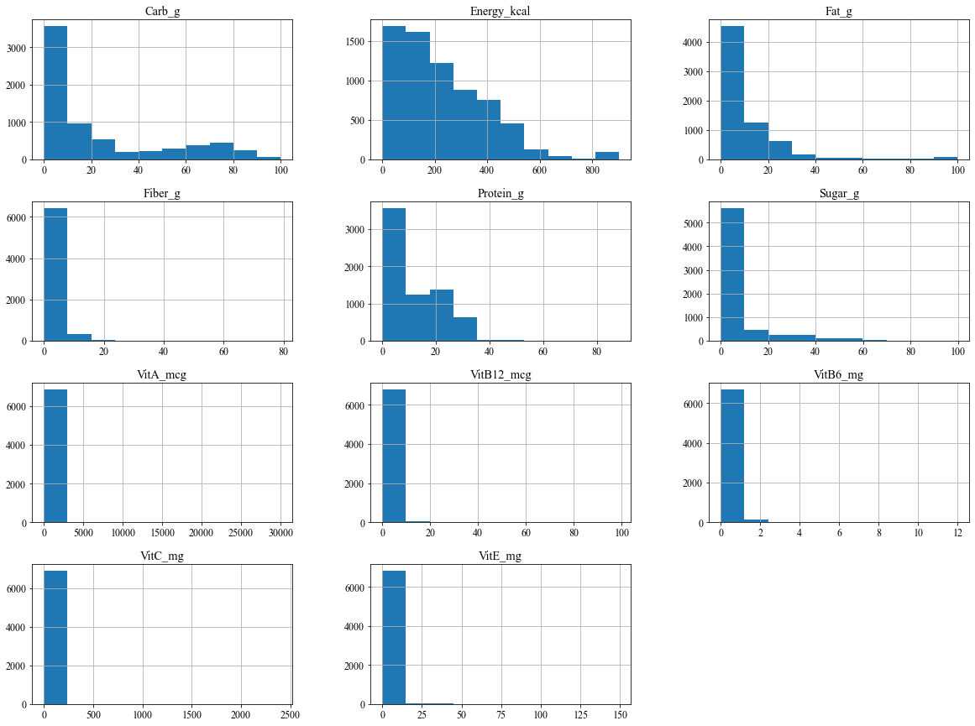
Data Examination

Slide 6
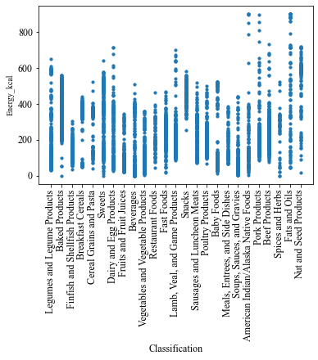
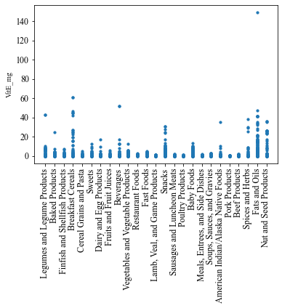
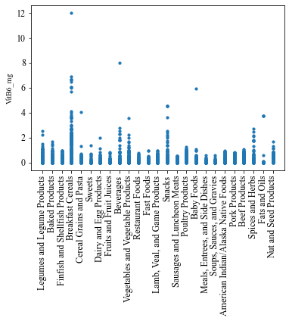
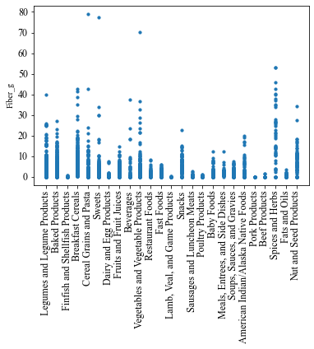
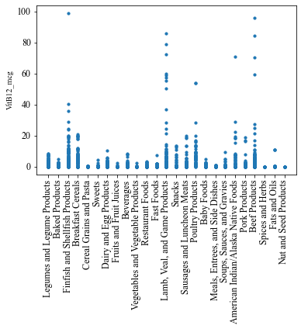
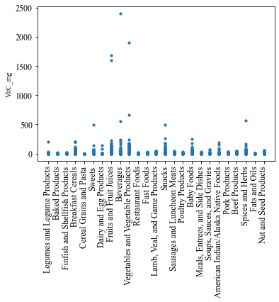
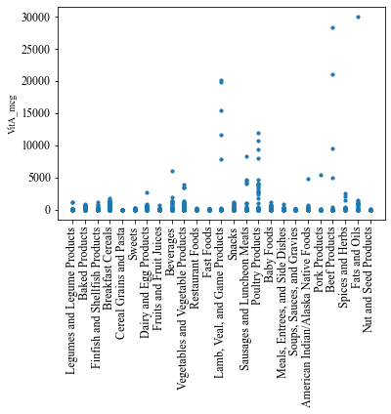
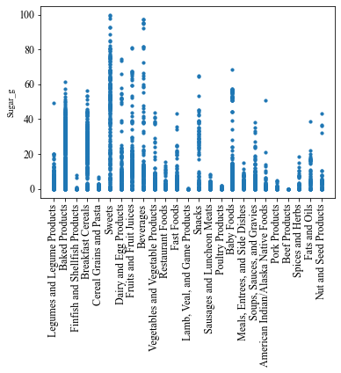
Checking value distribution in each nutrient

Slide 7
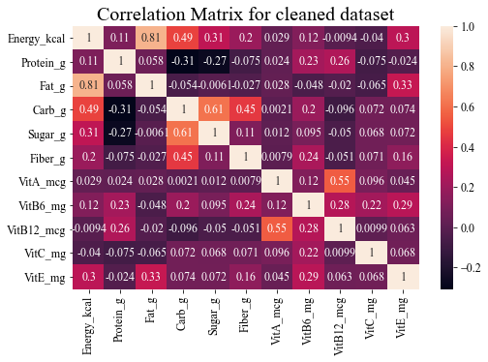
Correlation Matrix
Fat and Energy have highest correlation
There is a great variation of correlation

Slide 8
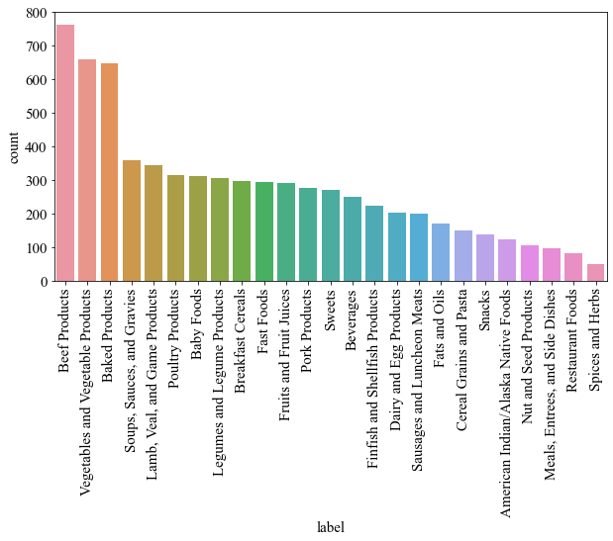
category_count

Slide 9

REsult

Slide 10
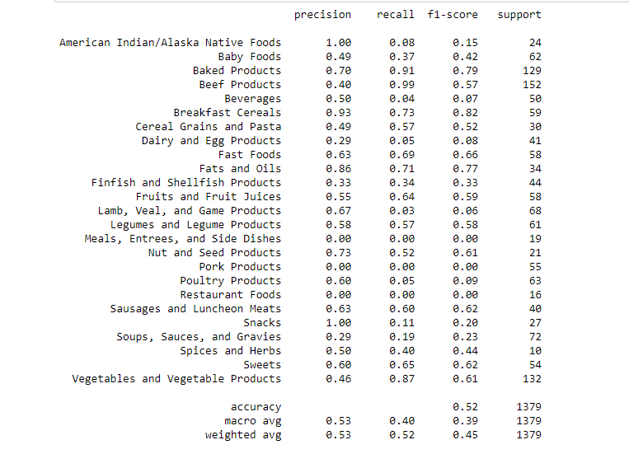
classification_report
There is great variation between the precision and recall values. This is because of data imbalance
This data imbalance can be fixed using data balance techniques
I have used SVM model, but other models can be used to improve the accuracy.
The accuracy can also by improved by considering more x parameters i.e. nutrient values in this case.

Slide 11
Limitations and Later work
Limitations:
Apart from the 12 popularly known nutrient values I have not considered other nutrient values
Since I have limited the nutrient consideration the accuracy of the model is just 52%
Not all the SVM parameters has been used.
Since the data is imbalanced the precision is varying
Later work:
Other Machine Learning models can be used to improve the accuracy.
This model can be implemented on real time machine to identify the food products
Data Balance technique can be employed.

Slide 12

Thank You!
https://github.com/ashuthoshc/RightFood_Healthylife

